Slide 1

18CSE392T – Machine Learning I
Unit V
Department of Data Science and Business Systems

Slide 2
Topics
Decision tree representation
Basic decision tree learning algorithm
Inductive bias in decision tree
Decision tree construction
Issues in decision tree
Classification and regression trees (CART)
Random Forest
Random Forest with scikit-learn
Multivariate adaptive regression trees (MART)
Introduction to Artificial Neural Networks
Perceptron learning
Department of Data Science and Business Systems

Slide 3
Decision Tree
Decision Tree is a Supervised learning technique that can be used for both classification and Regression problems, but mostly it is preferred for solving Classification problems.
It is a tree-structured classifier
where internal nodes represent the features of a dataset,
branches represent the decision rules and
each leaf node represents the outcome

Slide 4
Decision Tree
Decision Tree is a Supervised learning technique that can be used for both classification and Regression problems, but mostly it is preferred for solving Classification problems.
In a Decision tree, there are two nodes, which are the Decision Node and Leaf Node.
Decision nodes are used to make any decision and have multiple branches, whereas Leaf nodes are the output of those decisions and do not contain any further branches.
The decisions or the test are performed on the basis of features of the given dataset.

Slide 5
Decision Tree
The decisions or the test are performed on the basis of features of the given dataset.
It is a graphical representation for getting all the possible solutions to a problem/decision based on given conditions.
It is called a decision tree because, similar to a tree, it starts with the root node, which expands on further branches and constructs a tree-like structure.

Slide 6

Decision Tree
A decision tree simply asks a question, and based on the answer (Yes/No), it further split the tree into subtrees.
Below diagram explains the general structure of a decision tree:

Slide 7
Decision Tree
Why use Decision Trees?
There are various algorithms in Machine learning, so choosing the best algorithm for the given dataset and problem is the main point to remember while creating a machine learning model.
Below are the two reasons for using the Decision tree:
Decision Trees usually mimic human thinking ability while making a decision, so it is easy to understand.
The logic behind the decision tree can be easily understood because it shows a tree-like structure.

Slide 8
Decision Tree
Decision Tree Terminologies
Root Node: Root node is from where the decision tree starts. It represents the entire dataset, which further gets divided into two or more homogeneous sets.
Leaf Node: Leaf nodes are the final output node, and the tree cannot be segregated further after getting a leaf node.
Splitting: Splitting is the process of dividing the decision node/root node into sub-nodes according to the given conditions.
Branch/Sub Tree: A tree formed by splitting the tree.

Slide 9
Decision Tree
Decision Tree Terminologies
Branch/Sub Tree: A tree formed by splitting the tree.
Pruning: Pruning is the process of removing the unwanted branches from the tree.
Parent/Child node: The root node of the tree is called the parent node, and other nodes are called the child nodes.

Slide 10
Decision Tree
How does the Decision Tree algorithm Work?
In a decision tree, for predicting the class of the given dataset, the algorithm starts from the root node of the tree.
This algorithm compares the values of root attribute with the record (real dataset) attribute and, based on the comparison, follows the branch and jumps to the next node.
For the next node, the algorithm again compares the attribute value with the other sub-nodes and move further.
It continues the process until it reaches the leaf node of the tree.

Slide 11
Decision Tree
How does the Decision Tree algorithm Work?
Step-1: Begin the tree with the root node, says S, which contains the complete dataset.
Step-2: Find the best attribute in the dataset using Attribute Selection Measure (ASM).
Step-3: Divide the S into subsets that contains possible values for the best attributes.
Step-4: Generate the decision tree node, which contains the best attribute.
Step-5: Recursively make new decision trees using the subsets of the dataset created in step-3. Continue this process until a stage is reached where you cannot further classify the nodes and called the final node as a leaf node.

Slide 12
Decision Tree
Example
Suppose there is a candidate who has a job offer and wants to decide whether he should accept the offer or Not.
So, to solve this problem, the decision tree starts with the root node (Salary attribute by ASM).
The root node splits further into the next decision node (distance from the office) and one leaf node based on the corresponding labels.
The next decision node further gets split into one decision node (Cab facility) and one leaf node.
Finally, the decision node splits into two leaf nodes (Accepted offers and Declined offer).

Slide 13
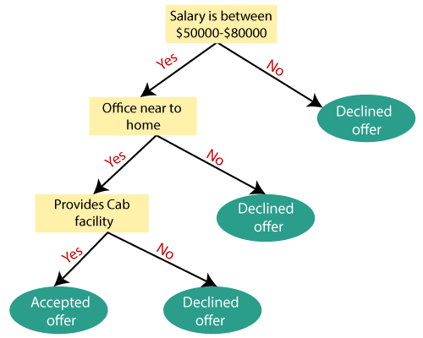
Decision Tree
Example

Slide 14
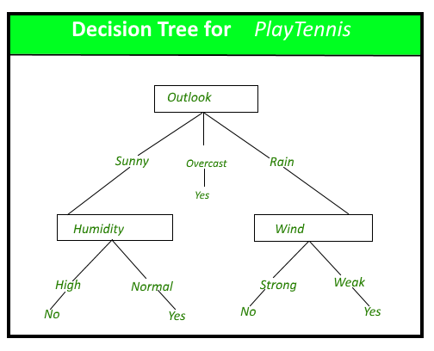
Decision Tree
Example

Slide 15
Decision Tree – Learning Algorithm
Attribute Selection Measures
While implementing a Decision tree, the main issue arises that how to select the best attribute for the root node and for sub-nodes.
So, to solve such problems there is a technique which is called as Attribute selection measure or ASM.
By this measurement, we can easily select the best attribute for the nodes of the tree.
There are two popular techniques for ASM, which are:
Information Gain
Gini Index

Slide 16
Decision Tree – Learning Algorithm
Attribute Selection Measures - Information Gain:
Information gain is the measurement of changes in entropy after the segmentation of a dataset based on an attribute.
It calculates how much information a feature provides us about a class.
According to the value of information gain, we split the node and build the decision tree

Slide 17
Decision Tree – Learning Algorithm
Attribute Selection Measures - Information Gain:
A decision tree algorithm always tries to maximize the value of information gain, and a node/attribute having the highest information gain is split first.
It can be calculated using the below formula:
Information Gain = Entropy(S) - [(Weighted Avg) * Entropy (each feature)]
Entropy: Entropy is a metric to measure the impurity in a given attribute. It specifies randomness in data. Entropy can be calculated as:
Entropy(s)= -P(yes)log2 P(yes)- P(no) log2 P(no)
Where,
S= Total number of samples
P(yes)= probability of yes
P(no)= probability of no

Slide 18

Decision Tree – Learning Algorithm
Attribute Selection Measures - Gini Index
Gini Index is a score that evaluates how accurate a split is among the classified groups. Gini index evaluates a score in the range between 0 and 1, where 0 is when all observations belong to one class, and 1 is a random distribution of the elements within classes.
An attribute with the low Gini index should be preferred as compared to the high Gini index.
It only creates binary splits, and the CART algorithm uses the Gini index to create binary splits.
Gini index can be calculated using the below formula:

Slide 19
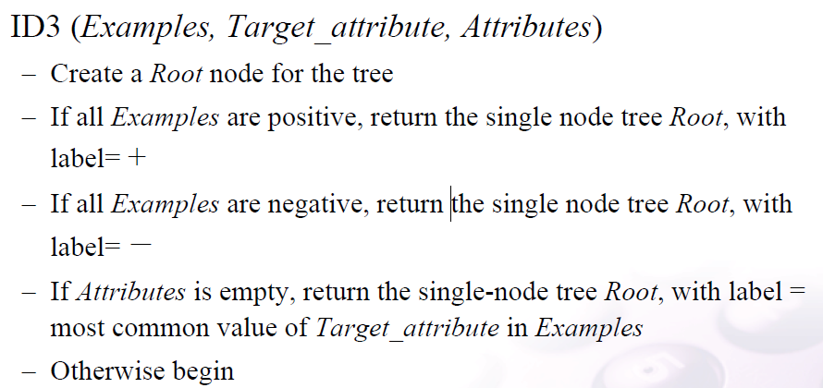
Decision Tree – Learning Algorithm
Algorithm
Contd.. in next slide

Slide 20
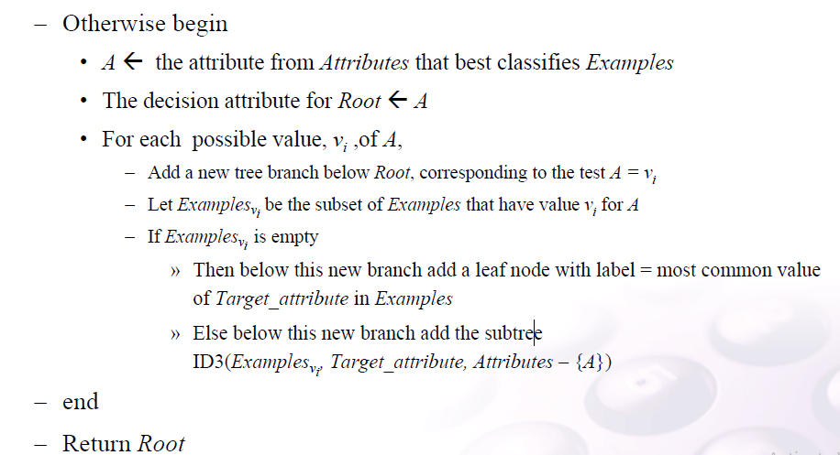
Decision Tree – Learning Algorithm
Algorithm

Slide 21
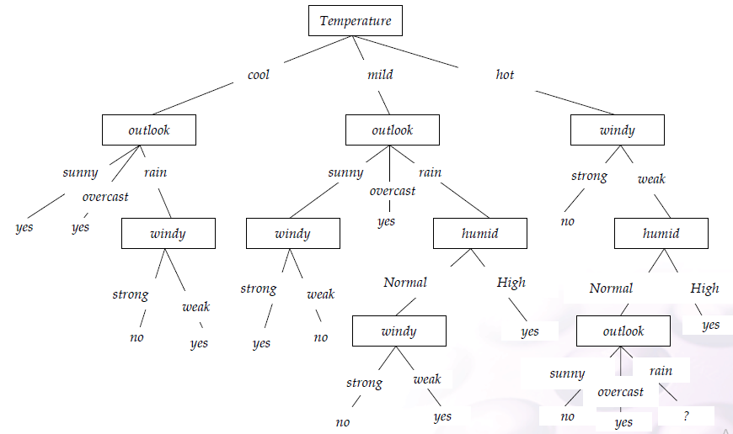
Decision Tree – Learning Algorithm
Illustrative Example

Slide 22
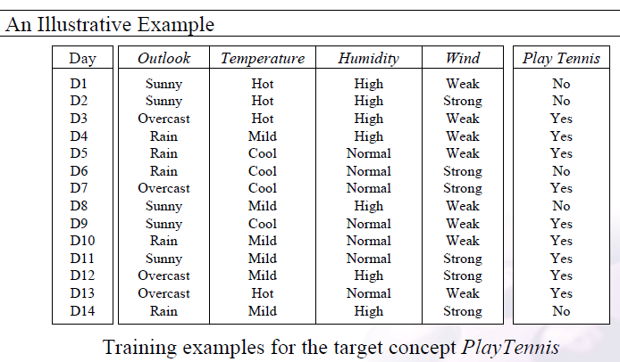
Decision Tree – Learning Algorithm
Illustrative Example

Slide 23
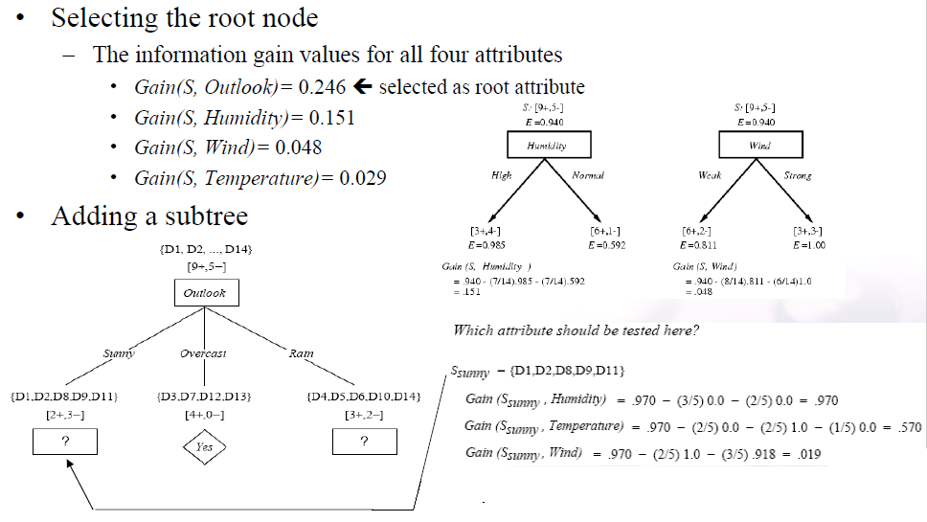
Decision Tree – Learning Algorithm
Illustrative Example

Slide 24
Inductive Bias in Decision Tree
Before learning a model given a data and a learning algorithm, there are a few assumptions a learner makes about the algorithm.
These assumptions are called the inductive bias.
It is like the property of the algorithm.

Slide 25
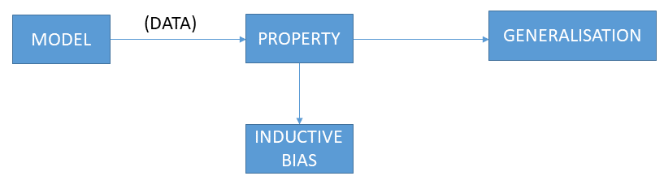
Inductive Bias in Decision Tree
For example, in the case of decision trees, the depth of the tress is the inductive bias.
If the depth of the tree is too low, then there is too much generalisation in the model.
Similarly, if the depth of the tree is too much, there is too less generalisation and while testing the model on a new example, we might reach a particular example used to train the model. This may give us incorrect results.

Slide 26
Issues in Decision Tree Learning
Determine how deeply to grow the decision tree
Handling continuous attributes
Choosing an appropriate attribute selection measure
Handling training data with missing attribute values
Handling attributes with differing costs
Improving computational efficiency

Slide 27
Random Forest
Random Forest is a popular machine learning algorithm that belongs to the supervised learning technique.
It can be used for both Classification and Regression problems in ML.
It is based on the concept of ensemble learning, which is a process of combining multiple classifiers to solve a complex problem and to improve the performance of the model.
As the name suggests, “Random Forest is a classifier that contains a number of decision trees on various subsets of the given dataset and takes the average to improve the predictive accuracy of that dataset.”
Instead of relying on one decision tree, the random forest takes the prediction from each tree and based on the majority votes of predictions, and it predicts the final output.

Slide 28
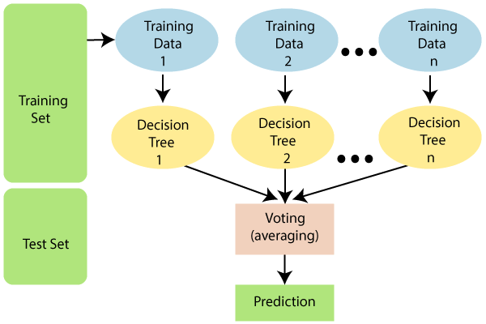
Random Forest
The greater number of trees in the forest leads to higher accuracy and prevents the problem of overfitting.
The below diagram explains the working of the Random Forest algorithm:

Slide 29
Random Forest
Why use Random Forest?
It takes less training time as compared to other algorithms.
It predicts output with high accuracy, even for the large dataset it runs efficiently.
It can also maintain accuracy when a large proportion of data is missing.

Slide 30
Random Forest
How does Random Forest algorithm work?
Random Forest works in two-phase
first is to create the random forest by combining N decision tree, and
second is to make predictions for each tree created in the first phase.
Step-1: Select random K data points from the training set.
Step-2: Build the decision trees associated with the selected data points (Subsets).
Step-3: Choose the number N for decision trees that you want to build.
Step-4: Repeat Step 1 & 2.
Step-5: For new data points, find the predictions of each decision tree, and assign the new data points to the category that wins the majority votes.

Slide 31
Random Forest
Example
Suppose there is a dataset that contains multiple fruit images.
So, this dataset is given to the Random forest classifier.
The dataset is divided into subsets and given to each decision tree.
During the training phase, each decision tree produces a prediction result, and when a new data point occurs, then based on the majority of results, the Random Forest classifier predicts the final decision

Slide 32
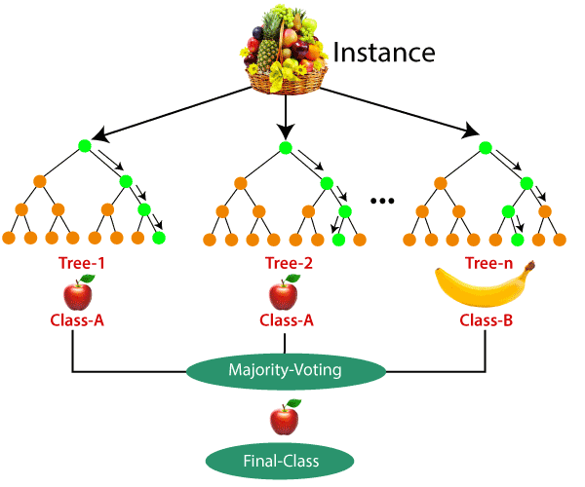
Random Forest
Example

Slide 33
Random Forest
Applications
There are mainly four sectors where Random forest mostly used:
Banking: Banking sector mostly uses this algorithm for the identification of loan risk.
Medicine: With the help of this algorithm, disease trends and risks of the disease can be identified.
Land Use: We can identify the areas of similar land use by this algorithm.
Marketing: Marketing trends can be identified using this algorithm.

